Slide 1

What do I look for in a survey dataset as a (crime survey) data user?
Survey Practice Forum: Challenges and Opportunities for Social Survey Data Collection in Scotland
Ben Matthews | University of Stirling

Slide 2
Overview
Why use surveys to measure crime?
Constructing a victimization time trend
Sample size and the crime drop
Sampling frames and victimization

Slide 3
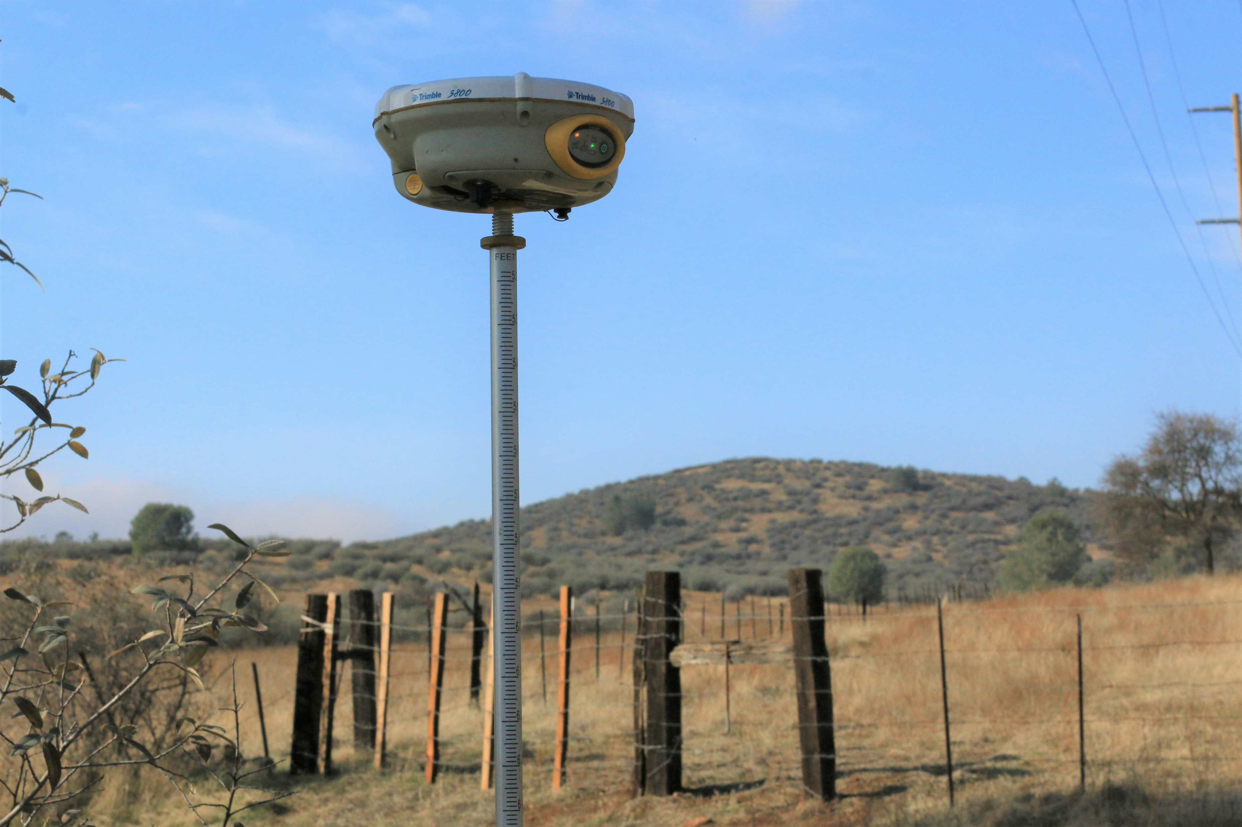
Why surveys?
Photo by Scott Blake on Unsplash

Slide 4
Why crime surveys?
How much crime is there?
Actually quite hard to know
We can just rely on data from the criminal justice system: we need triangulation across data sources due to the ‘dark figure’ of crime
Identifying the gap between survey reports of victimization and police recorded crime was the key (and radical) innovation of crime surveys
Buil-Gil, D., Brunton-Smith, I., Pina-Sánchez, J., & Cernat, A. (2022). Comparing measurements of violent crime in local communities: a case study in Islington, London. Police Practice and Research, 23(4), 489–506. https://doi.org/10.1080/15614263.2022.2047047

Slide 5
Surveys don’t just happen
Crime data triangulation is not a big problem “in countries where alternative forms of data beyond official criminal justice statistics are obtainable, such as victim surveys”
But is “formidable particularly outside consolidated western democracies where the range of available data is often limited.”
Kıvanç Atak, Beyond the western crime drop: Violence, property offences, and the state in Turkey 1990–2016, International Journal of Law, Crime and Justice, Volume 60, 2020, https://doi.org/10.1016/j.ijlcj.2019.100373.

Slide 6

Surveys as knowledge infrastructure
Knowing that data will be archived and available years from now (and that data from years ago is archived) is key to exploring change over time
Established social surveys are part of the ‘knowledge infrastructure’ in a way that ‘big data’ or administrative data sources aren’t always

Slide 7

Constructing a time trend
Photo by Anne Nygård on Unsplash

Slide 8
Getting the most from established surveys
Established surveys let you:
Examine change over time
Analyse small population groups after pooling sweeps together to increase sample size
Ideally, both
But there are practical challenges in using these data
And open questions about how best to analyse them

Slide 9
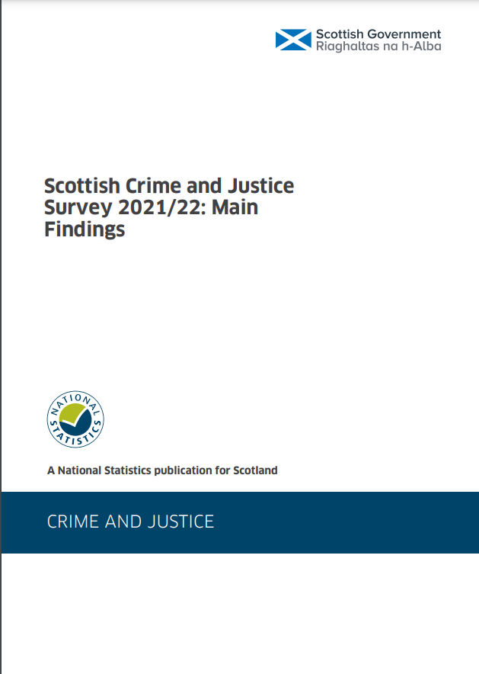
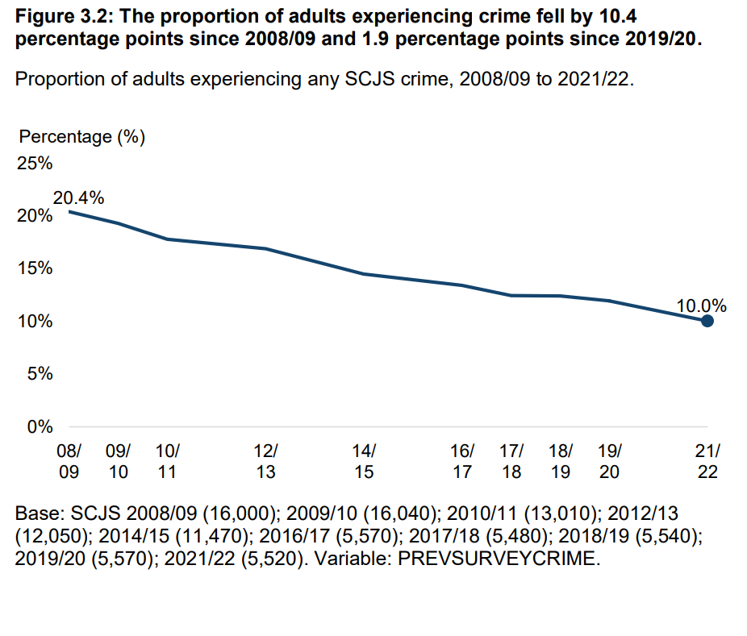

Slide 10
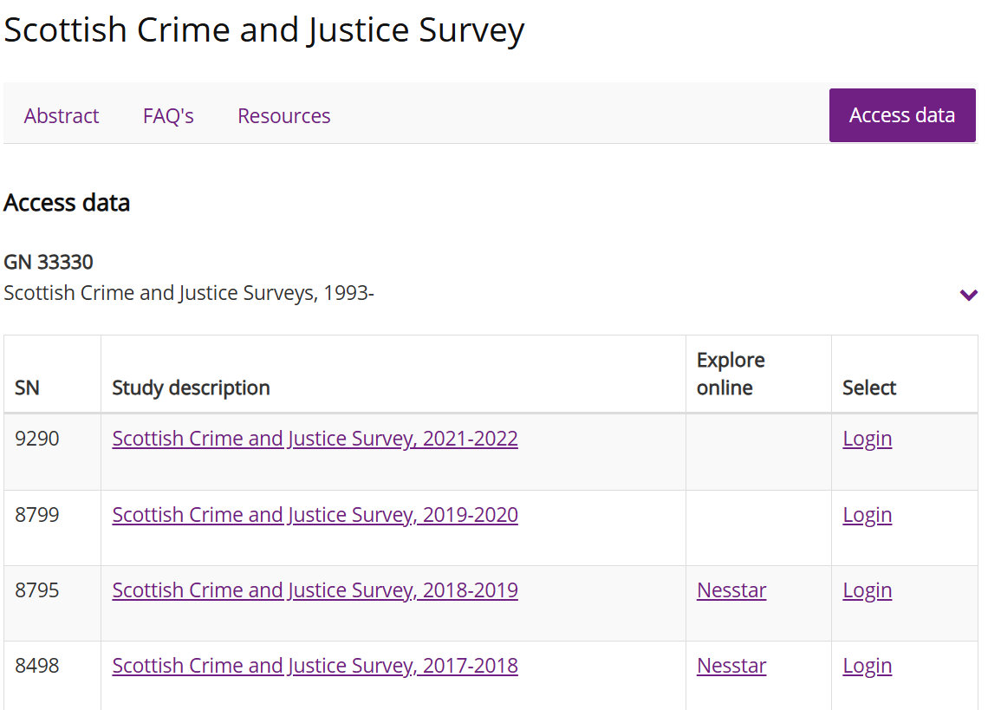

Slide 11
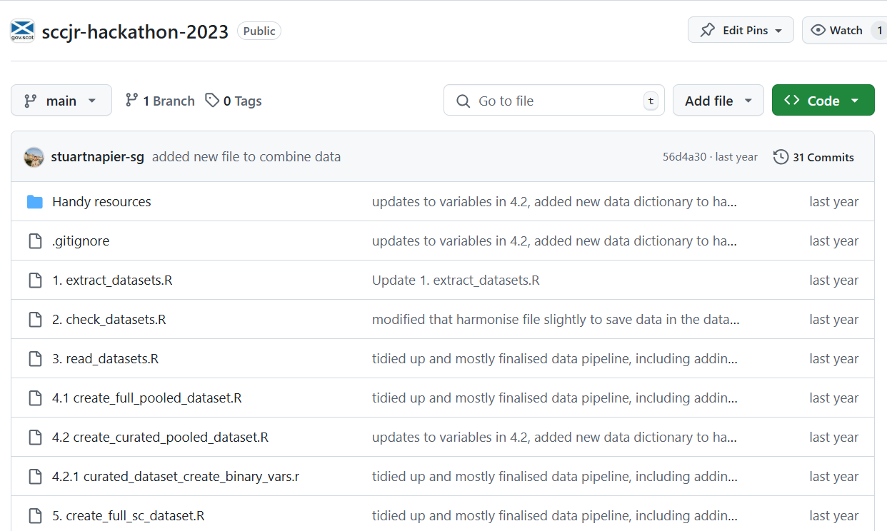

Slide 12
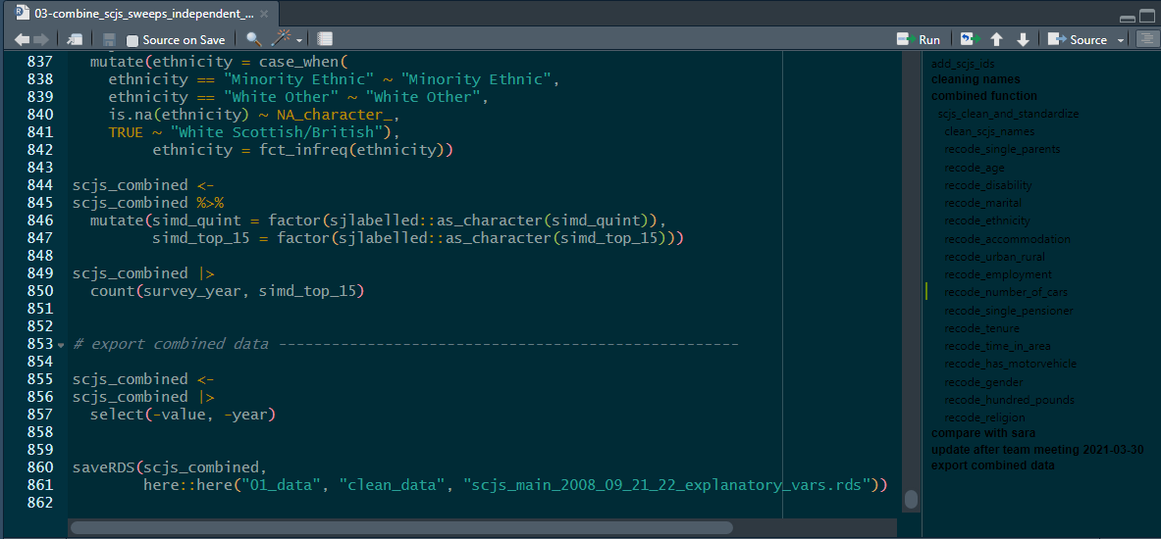


Slide 13
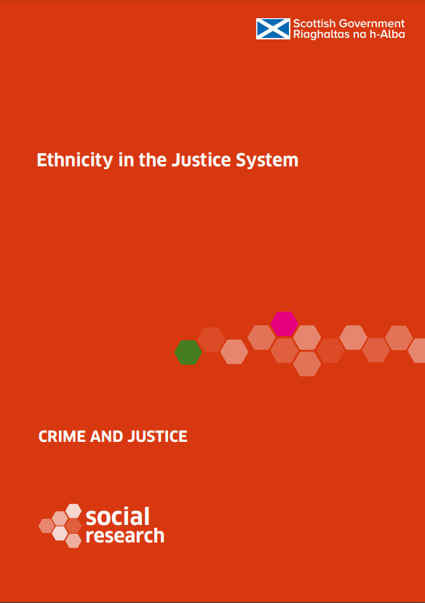
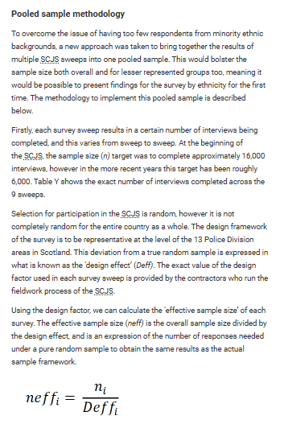
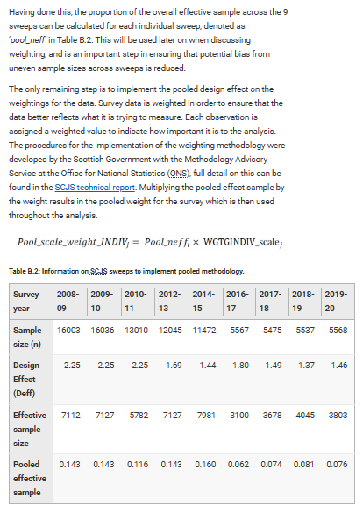

Slide 14
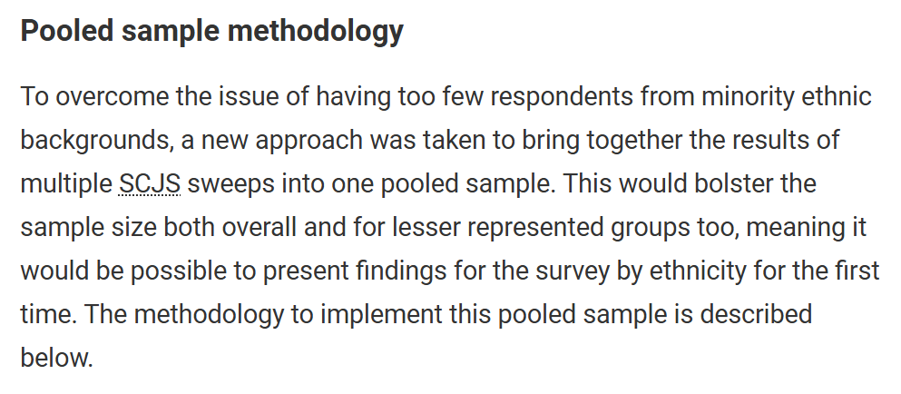
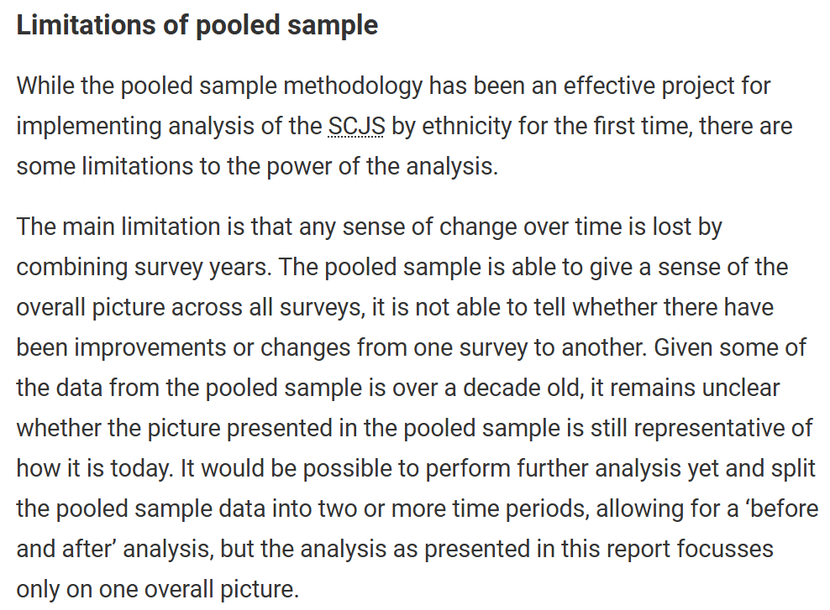


Slide 16
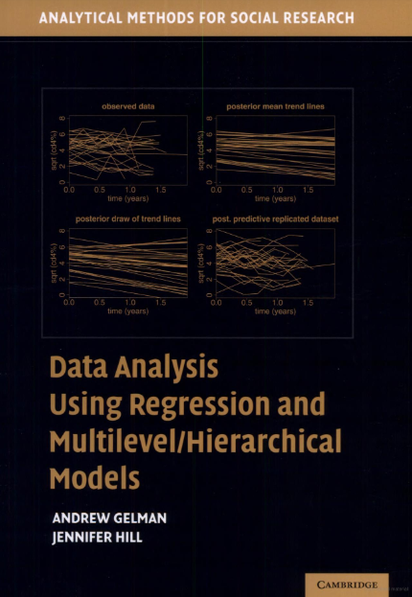
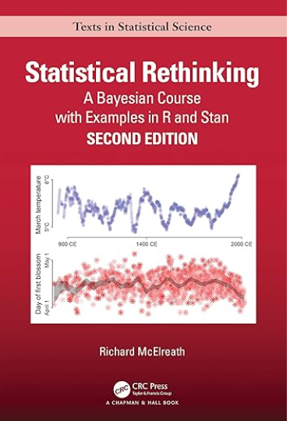

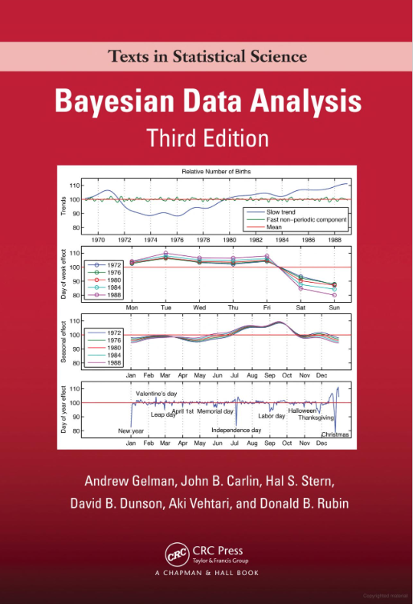
?
?
?
?
?
?
?
?
?
?
?
?
?
?
?
?
‘Complete pooling’
‘Partial pooling’
‘No pooling’
Treats people from every sweep as if they are the same
Treats people from every sweep as if they are completely different

Slide 17

Sample size and the crime drop
Photo by Daniele Levis Pelusi on Unsplash

Slide 18



Slide 19
Sample size and the crime drop
Bell et al. (2024, January). Scottish Crime and Justice Survey 2021/22 Technical Report. https://www.gov.scot/binaries/content/documents/govscot/publications/statistics/2023/11/scottish-crime-justice-survey-2021-22-main-findings/documents/technical-report/technical-report/govscot%3Adocument/Crime%2BSurvey%2B-%2B2021-22%2B-%2BTechnical%2BReport.pdf
* Own calculations
 | 2008/09 | 2021/22 | Change
Response rate | 70.9% | 47.3% | -23.6 %pt
Core achieved sample | 16,003 | 5,516 | -65%
Victimization prevalence | 20.4% | 10.0% | -51%
Number of victims interviewed* | 2,786 | 532 | - 81%
Number of repeat victims interviewed* | 1,083 | 164 | - 85%

Slide 20
Sample size and the crime drop
There is an irony here: adults in general don’t have much of an experience of crime – victimization prevalence as estimated by the SCJS was ~10% in the most recent sweeps
So general population victimization surveys are less able to explore victims’ experiences of crime unless they increase sample size over time
This is even more true for repeat victims
Scottish Women’s Aid. (2021, December). Response to the consultation on the Scottish Crime and Justice Survey (SCJS), December 2021. https://womensaid.scot/wp-content/uploads/2022/04/SWA-response-to-Scottish-Crime-and-Justice-Survey-consultation.pdf

Slide 21
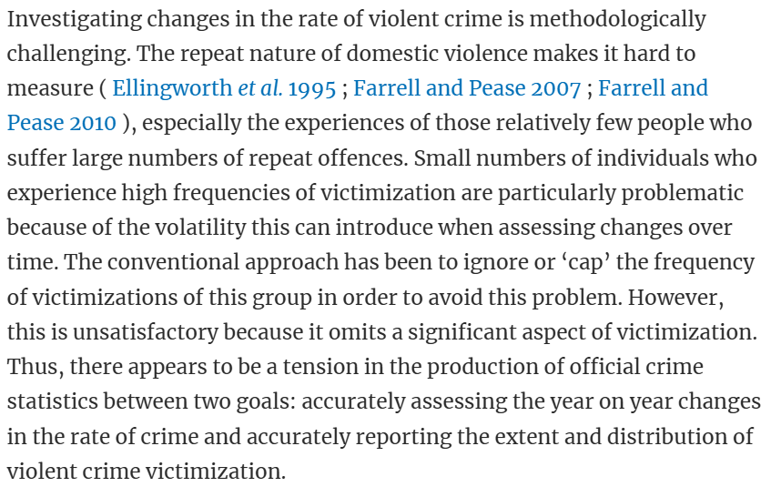




Small numbers means more volatility
Sylvia Walby, Jude Towers, Brian Francis, Is Violent Crime Increasing or Decreasing? a New Methodology to Measure Repeat Attacks Making Visible the Significance of Gender and Domestic Relations, The British Journal of Criminology, Volume 56, Issue 6, November 2016, Pages 1203–1234, https://doi.org/10.1093/bjc/azv131

Slide 22
The crime drop and survey design
There is a tension between the aims of providing ‘a valid and reliable measure of adults’ experiences of crime’ and ‘examin[ing] trends over time in the number and nature of crimes in Scotland’
These are not specific to SCJS but maybe more acute than with e.g. Crime Survey for England and Wales due to smaller sample size

Slide 23

Sampling frame
Photo by Angèle Kamp on Unsplash

Slide 24
The ‘average’ person
Nationally representative sample surveys are designed to reflect the experience of the average person or household
“The SCJS is a random probability sample survey of private households” using the Royal Mail Postcode Address File (PAF)
SCJS aims to “provide a valid and reliable measure of adults' experience of crime”…
Saunders, A., Caldwell, K., Magnani, L., Cook, B., Page, L., Rose, J., Martin, C., & Hockaday, C. (2021). Scottish Crime and Justice Survey 2019/20: Technical Report. Scottish Government. p.13

Slide 25
Sampling frames and victimization
… but if we want a measure of crime for all adults, not just all adults in private households, we need to assume that “the subset of the adult population not captured in the SCJS experience the same level of victimisation as adults in the household resident population”¹
But this excludes homeless people, students, people in prison, nomadic/itinerant populations and those living in refuges ²
¹ Scottish Women’s Aid. (2021, December). Response to the consultation on the Scottish Crime and Justice Survey (SCJS), December 2021. https://womensaid.scot/wp-content/uploads/2022/04/SWA-response-to-Scottish-Crime-and-Justice-Survey-consultation.pdf
² Carr-Hill, R. (2013). Missing Millions and Measuring Development Progress. World Development, 46, 30–44. https://doi.org/10.1016/j.worlddev.2012.12.017

Slide 26
Sampling frames and victimization
If the outcome you’re interested in (victimization) affects selection into the survey – like in our examples – this is not a ‘problem’ that can be solved’ other than some specific scenarios
Adults in private households and all adults are just different target populations – neither is necessarily right or wrong for a given application
Schuessler, J., & Selb, P. (2023). Graphical Causal Models for Survey Inference. Sociological Methods & Research, 00491241231176851. https://doi.org/10.1177/00491241231176851

Slide 27
Thank you
Survey Practice Forum: Challenges and Opportunities for Social Survey Data Collection in Scotland
ben.matthews@stir.ac.uk

